Slide 1
Information Security Awareness Training

Slide 2
Review elements of JWU’s Written Information Security Policy (WISP)
When we are done today, you should be able to:
Identify Personally Identifiable Information (PII)
Protect various forms of PII under your supervision
Understand the concepts of Information Security and “safe data handling & computing practices”
Describe reporting protocol for breaches

Slide 3
You are the target…
You, and your access to University data, are now the primary target of hackers.
Gaining access to your login information allows them to impersonate you, or use your computer, to gain access to JWU systems and data.
Technology can address only a fraction of security risks. Human error is one of the biggest security threats that organizations face!
'Human error was a major contributing cause in 95% of all breaches.' — IBM Cyber Security Intelligence Index Report.

Slide 4
What is Sensitive Data?
JWU handles a great deal of sensitive protected information, including data known as Personally Identifiable Information commonly called PII. PII is targeted by hackers because it is highly valuable information that can be used for identity theft, fraud, or used to attack other organizations.
Each of us is responsible for the protection of any sensitive data that we handle as part of our various roles and responsibilities.

Slide 5
What is personally IDENTIFIABLE information (PII)?
Any Information that can:
Be used to uniquely identify, contact, or locate a single person
Can be used with other sources to uniquely identify a single individual
Notes:
PII is ―any information about an individual, including (1) any information that can be used to distinguish or trace an individual‘s identity, such as name, social security number, date and place of birth, mother‘s maiden name, or biometric records; and (2) any other information that is linked or linkable to an individual, such as medical, educational, financial, and employment information.

Slide 6
PII includes a Name in combination with:
Social Security Number (“All or Part”)
Financial account number, including credit and debit card numbers, JWU Source Card (e.g., checking, savings, broker’s account, PIN#’s, expiration date, information on the magnetic strip and the 3-digit code, etc.)
Driver's license number or government- issued identification number (Military ID, Passport, etc.)
Parent’s legal last name prior to marriage
Digital signatures
Employee healthcare information
Biometric data (such as fingerprints)
Notes:
First name or first initial and last name. Common definition: PII is any piece of information which can potentially be used to uniquely identify, contact, or locate a single person. PII can be used to expose individuals to identity theft and other crimes.
Not included within this category are medical records of employees received by the university in its capacity as an employer and workers’ compensation records.

Slide 7
Is PII the only information that we need to protect?
No! PII is the most sensitive information and has the most stringent security requirements. However, there are other categories of information that need to be protected using reasonable security measures identified by the university Chief Information Security Officer (CISO):
  J Numbers
  Dates of Birth
  Education records
  Employee records
  Confidential information under contracts
Notes:
First name or first initial and last name with date of birth.

Slide 8
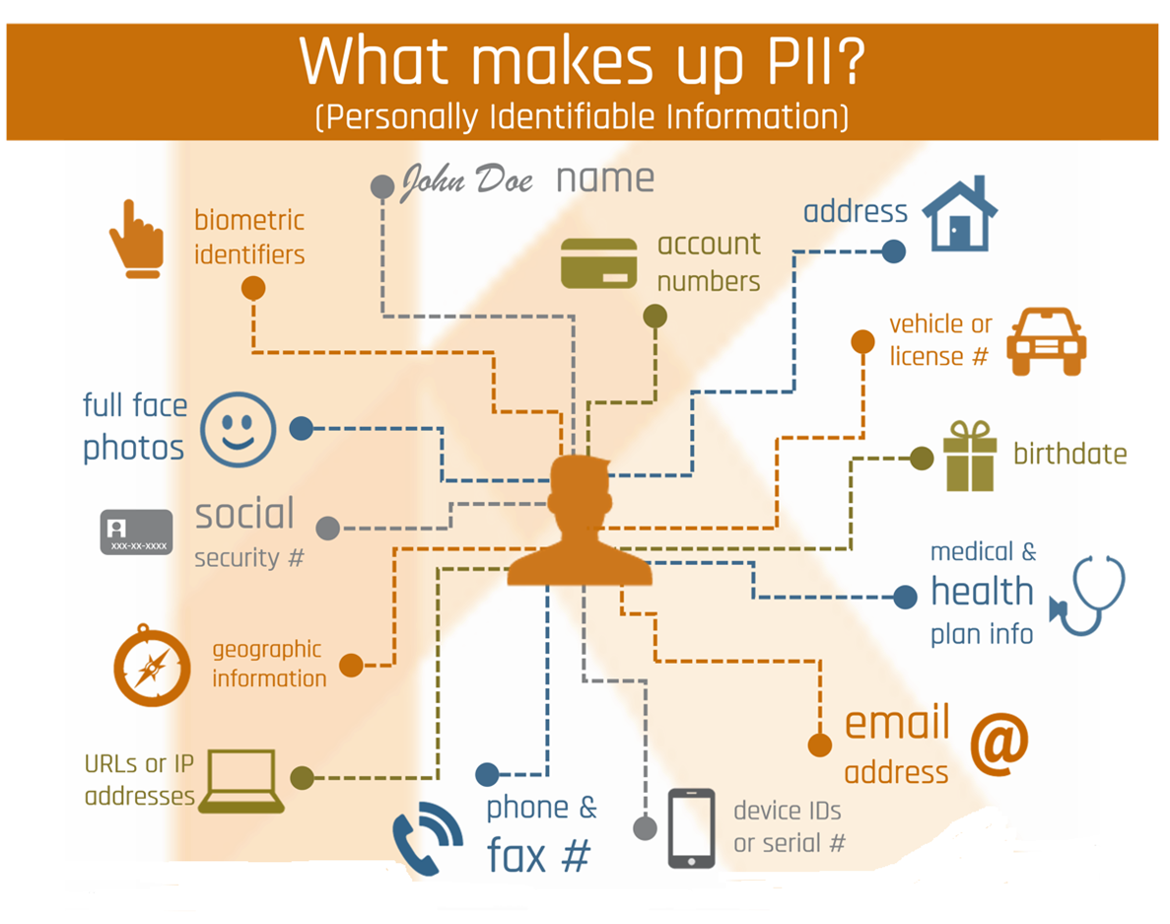

Slide 9
How do we protect PII?
Ensure the confidentiality, integrity, and availability of information through safeguards (Information Security measures)
Confidentiality: That data/information is accessible only to those authorized to have access. Ensure that the information will not be disclosed to unauthorized individuals or processes.
Integrity: Assurance that data and information are consistent and correct, not only from the origination point, but also when transferred to another point. Ensure that the condition of information has not been altered or destroyed in an unauthorized manner, and data is accurately transferred from one system to another.
Availability: The timely and reliable access to data services for authorized users.
Notes:
CIA Information Security Principles. SECURITY AWARENESS is set in context of Information Security. This slide introduces some concepts that fall under information security. Information security is ALWAYS in terms of CIA: Confidentiality is the ability to keep certain information private, to keep it from being shared inappropriately. If information is shared inappropriately the organization can be held liable for the negative consequences to clients and for mitigation efforts. THIS IS PRIVACY.
Integrity is the ability to protect information and systems from malicious or accidental modification or corruption. Integrity is ensuring that the data is what it represents, that it has not been modified or deleted in some way. Programs will not be able to collect information or the information is worthless if it is not in a usable condition. Availability is the reliable and timely access to data and resources by authorized individuals. The public, the Entity and it’s partners soon become dependent on automated IT systems. When these systems are down, users become frustrated and could avoid using automated systems in the future, thus increasing the Entity’s manual processing workload, or worse, delay or stop the delivery of services.

Slide 10
WHAT IS HUMAN ERROR IN COMPUTER SECURITY?
In a security context, human error means unintentional actions - or lack of action - by employees and users that cause, spread or allow a security breach to take place.
This encompasses a vast range of actions - from downloading a malware-infected attachment to Misdelivery - sending an email containing protected data to a wrong recipient.

Slide 11
Protection of PII
Unless PII is necessary to accomplish a legitimate business purpose for JWU (or as otherwise required by law),
DON’T ASK FOR IT, COLLECT IT, KEEP IT, OR GIVE/SEND IT!
Do not disclose or grant access to PII to a Third Party Vendor unless approved by the CISO.
Any vendor who will receive PHI (Protected Health Information) needs to have a “business associate agreement” and undergo an Information Security capabilities review by the Office of Information Security Services (ISS).
Friends or Family Members who use a personal device which connects to a JWU system must not have access to PII.

Slide 12
How PII is exposed:
1. Accidents – inadvertent exposure.
  Reduce risk by:
• Eliminating sensitive data from desktops, laptops, USB drives, departmental paper files, scanned images, etc.
• Using safe computing practices (strong passwords, ignoring phishing emails).
2. Attacks – deliberate intent to capture data.
  Reduce risk of attacks from insiders and outsiders by:
    encrypting data
    physically securing files, etc.

Slide 13
Responsibility for the Written Information Security Plan (WISP)
The Chief Information Security Officer (CISO) has primary responsibility for the policy.
Responsible for implementation, training, review and maintenance of the policy, and incident response and investigation.
Contact the Office of Information Security Services with any questions regarding the WISP (Office 401-598-3030, 3031, 3032, 1558).

Slide 14
Director of Information Security (ISM)
Other important CISO responsibilities:
3rd Party Vendor Contracts must be approved by the CISO (vendors who access use, store, disclose, transport or destroy PII)
Obtain written approval from the CISO if your department wants to use any service involving payment by credit or debit/payment cards
This required approval includes the following:
  Engaging a vendor for a service with these payment methods, obtaining a web service incorporating these payment methods (e.g., PayPal), obtaining a credit card machine

Slide 15
Good Computing Practices:
Safeguards and roles for Users

Slide 16
What is “Information Security”?
Identity Theft
Confidentiality
Safeguard identity and password
Email
Reputation
Availability
Virus
Integrity
Copyright

Slide 17
Email Security
Email is one of the most common and most successful attacks on the internet. Recent statistics cite up to 90% of successful attacks against businesses begin with a malicious email.
Emails can contain malicious files like virus and malware, link to malicious web sites, or try to coerce or convince you to give away personal information, like your username and password.
Cybercriminals using email to attack businesses are becoming more and more effective at evading detection – technology alone is only marginally effective at blocking these new email threats.

Slide 18
Email Do’s and Don’ts
Do:
Always verify the sender of a message.
Always hover over web page links (URLs) in email messages to see where they link to – beware URL shortening services (like bit.ly) that may obscure the final web site destination.
Be skeptical of messages with odd spelling/grammar, improper logos or that ask you to upgrade or verify your account.
Report suspicious emails to phishing@jwu.edu.
Don’t:
Open an attachment from an unknown sender. Consider the source and whether or not the file was expected.
Click on a link from an unknown sender.
Email someone your username or password.

Slide 19
Email Threat Examples
Phishing
Viruses and Malware
Email Spoofing
Other Scams

Slide 20
Phishing
Phishing is the attempt to obtain sensitive information such as usernames, passwords, and credit card details (and, indirectly, money), often for malicious reasons, by disguising as a trustworthy entity in an electronic communication.
Common phishing scams attempt to use coercion or scare tactics to get you to enter your username and password into a phony web site, such as:
  A “required action” as a part of a system or quota upgrade
  A “required action” to prevent email account closure
  A “trusted” vendor, such as a fake Dropbox or Google alert
  A “legitimate” banking alert
Once they have your password, phishers use your account credentials to send more phishing messages, change financial account information or redirect checks/deposits.

Slide 21
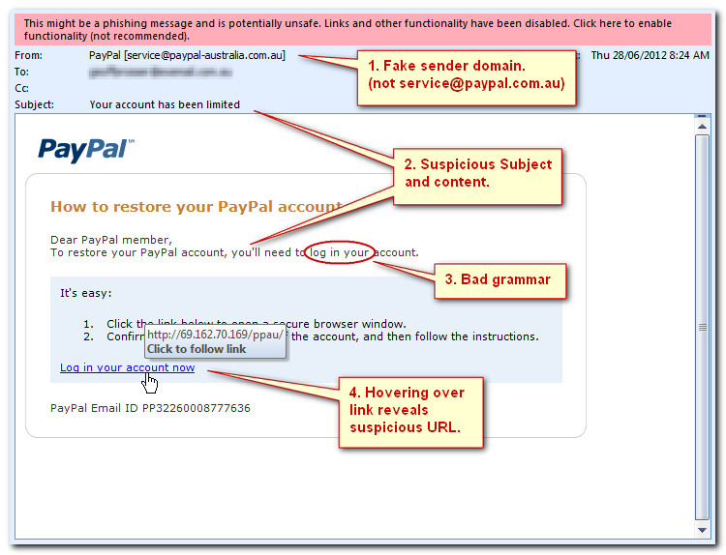
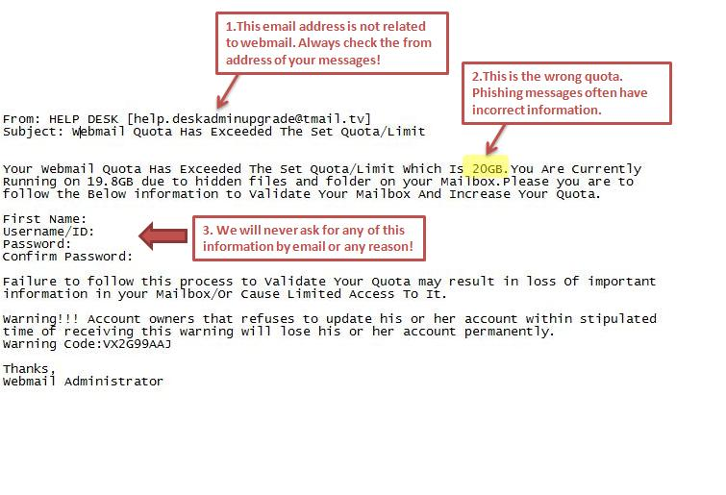
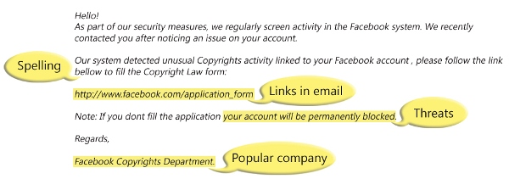
Phishing Examples

Slide 22
Viruses and Malware
Cybercriminals also use attachments to spread viruses or other malicious software (malware) to steal or destroy data.
Malware can install keyloggers to capture everything you type, control your webcam/microphone, or send all of your data to remote servers that the criminal controls.
The attachment typically arrives as Word, Excel or PDF file and has to be opened before the malware triggers.
Malware will take advantage of unpatched software.
Some Word/Excel malware require you to enable Macros – always be suspicious of an attachment that requests you to “lower” your security settings when opening.

Slide 23
Ransomware
Ransomware is a new type of malware that encrypts documents, pictures and other files, making them unreadable.
The attacker then holds the decryption key for ransom until you agree to pay money, usually through an untraceable method such as BitCoin or other digital currency.
Backing up your files is a very important protection against Ransomeware.
On JWU computers, back up files to your G (personal) or H (shared) drives.
  G Drive: email archives & working versions of documents
  H Drive: shared files owned by JWU which require to be accessed by more than one user
  Do not save files to computer local disk (C Drive).
For personal computers, use external drives or trusted cloud services.

Slide 24
Email Spoofing
Also called Business Email Compromise, email spoofing typically uses an email address that mimics a trusted party, such as a manager, executive or co-worker, and can be difficult to recognize (especially on mobile devices).
Typically these scams involve a wire transfer or request for sensitive files, such as W-2s or legal documents.
There is usually some urgency involved to prevent the recipient from following up on the request directly or following procedures.

Slide 25
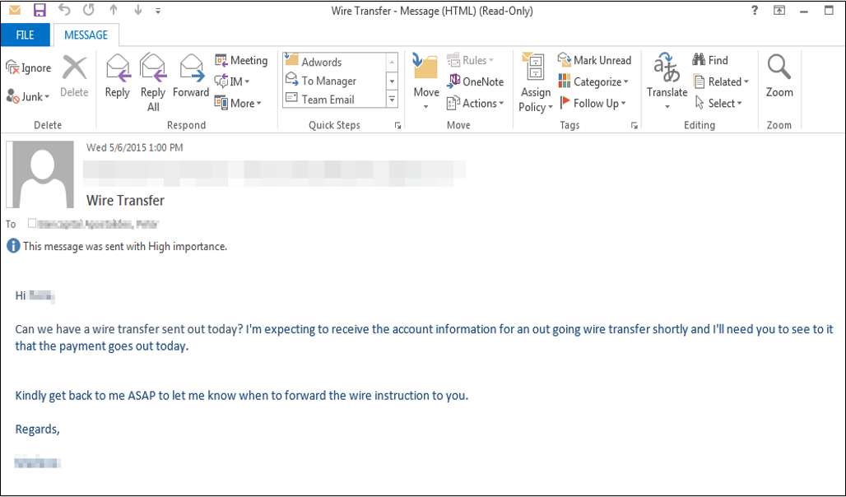
Email Spoofing Example
Notes:
https://www.phishlabs.com/blog/what-is-email-spoofing/

Slide 26
Safe Web Browsing
Hover over URLs and links.
Make use of pop-up and ad blockers.
Be aware of where Google or other web searches are sending you.
Be careful when downloading software from the internet.
If a website requests user information of any kind, make sure that website is using HTTPS. Look for the padlock or other indicators that the page is secure, such as a site that begins with https://
Notes:
Discuss “hovering” in more depth – potentially show example.

Slide 27
Privacy
Social media and networking sites, by definition, collect, maintain, and share personal information.
Be mindful of what information you share about yourself and your family online or with others in electronic communications.
Social networking sites can be used by attackers to collect information about you to use against you. Social engineering attempts to use information the attacker knows about you and your relationships with others to your build trust.
Always check your sharing settings to limit the information you share with public or untrusted users.

Slide 28
Administrative Standards
Access to PII is granted only to authorized individuals with a “need to know.”
Installation of software without prior approval and vetting is prohibited.
Disclosure of PII via electronic means is strictly forbidden without appropriate authorization.
Do not use computer equipment to engage in any activity that is in violation of the JWU policies and procedures or is illegal under local, state, federal, or international law.

Slide 29
Physical Safeguards
Limiting access to the buildings, areas, and rooms in which data and equipment are located is vital. If a vendor requires access to our systems or equipment, they must:
  Display a JWU-issued ID card (for example, our regular, assigned HP representative who performs maintenance on our printers carries such a card), OR
  Be accompanied by an IT staff member, OR
  Have previously scheduled a visit, through IT, with you or your department head
Unless the visitor meets one of these criteria, do not allow them access. Should you ever feel uncertain about the legitimacy of an IT vendor seeking information or access, please call the IT Service Desk at 401-598-HELP (4357).
Notes:
Call 866-598-4357
Call 401-598-4357
Email it@jwu.edu
Fax 401-598-1511

Slide 30
Physical Standards – Workstations
Position workstations so as to avoid viewing by unauthorized personnel.
Maintain a clean desk area. Ensure that all sensitive/confidential materials are removed from your workspace and locked away when the items are not in use or when you leave your workstation.
Lock, logoff or shut down workstations when not attended.

Slide 31
How may PIRN be stored electronically?
Back up digital data to your G (personal) or H (shared) drives.
  G Drive for email archives, working versions of documents
  H Drive for shared files owned by JWU which require to be accessed by more than one user
  Do not store to local disk (C Drive)!
PIRN may only be externally stored on IT Department issued portable devices and media, which are encrypted and secured!
  Examples are Laptops, smart phones, Ipads, thumb/jump drives and any other computer hardware and equipment provided to you by the IT Department.
This also includes other categories of information such as:
  Student names, J Numbers, class rosters and grades (Education records).
Notes:
Protect the devices from loss and damage. G Drive for email archives, working versions of documents. H Drive shared files owned by JWU needed to be accessed by more than one user.

Slide 32
Email and attachment encryption is a function of Outlook Office 365 and the approved method for secure electronic transfer of PIRN/PII.
There is a difference between encrypting the body of an email and encrypting attachments to an email.
  To encrypt the body of an email: Type the word Encrypt in the subject line of a JWU email will ensure that the body of the email is encrypted. Only the recipient of the email will be able to open it and read it.
  To encrypt an email attachment: the attachment needs to be encrypted before attaching it to an email and the recipient needs to be given the proper password or method of unencrypting it outside of Outlook. An email that has the body of the email encrypted does not mean that any attachment will be encrypted.
Emails between jwu.edu accounts are ‘automatically’ encrypted meaning that they are encrypted in transit and only the recipient will be able to read the body of the email.

Slide 33
Internet Use
Be suspicious of accessing sites offering questionable content. These often result in spam or the release of viruses.
Be careful about providing personal, sensitive or confidential information to an Internet site or to web-based surveys that are not from trusted sources (personal information can be utilized to access JWU systems).
Remember: The Internet is not private! Access to any site on the Internet could be traced to your name and location.

Slide 34
JWU Email & Password Management
It is prohibited to utilize JWU email and password for non university related access (e.g., personal ISP account, linkedin, banking, social media, etc.).
  It is prohibited to utilize your JWU email and password for any non university related accounts (LinkedIn, social media, shopping sites, etc.).
  When you use JWU email and the same password, you make it easier for hackers to access university network resources.
  This is known as a credential stuffing attack. Hackers can easily obtain lists of stolen usernames and passwords from data breaches, and they utilize these lists to access the JWU network resources.
A password management utility is one option for storing passwords. KeyPass is a password management utility that is provided to all university employees and can be down loaded at https://kace.jwu.edu/userui/software_detail.php?ID=1

Slide 35
Indication of tampered accounts…
your account is locked when you try to open it
your password isn’t accepted
you’re missing data
your computer settings have mysteriously changed
If you suspect someone has tampered with your account, call the Help Desk!

Slide 36
Signs of Malware are…
Reduced performance (your computer slows or “freezes”)
Windows opening by themselves
Missing data
Slow network performance
Unusual toolbars added to your web browser
Contact the Help Desk if you suspect that your computer has been compromised!

Slide 37
Procedures for All Users if you suspect compromise
After contacting Help Desk:
Stop using the computer immediately
Leave computer ON
Disconnect from the network
ISS will respond and will conduct an investigation
***Especially critical if your computer has access to PII data***

Slide 38
Acceptable Use of Computers
End Users (read “YOU-ALL”) are responsible for any violations associated with their User ID
Use of computer system must be consistent with JWU’s goals, policies and procedures
All computer equipment and electronic data created by it belong to JWU
Must utilize only IT approved applications and software to conduct university business
Must comply with all Federal and State laws
Must comply with software licensing rules

Slide 39
Data Management and Security-
Data Disposal
Securely destroy PII data which is no longer needed per the university Record Retention Policy.
Best practices dictate that we minimize data we maintain insofar as reasonably possible consistent with our need to operate.
Place hard drives, CDs, zip disks, or any backup devices for appropriate safe disposal or recycling in dedicated secure digital media bins located in HR (managed by ISS). All will be “Cleaned” of all data prior to disposal. Documentation will be provided by ISS.
Hardcopy documents and reports
  Utilize shredders and secure disposal containers in the workplace.
Hard-drives will be “Cleaned” (degaussed) of all data prior to reassignment by IT Staff.
Notes:
CIARM sponsors an annual “ShredderFest” event during the month of October. If you are not certain on retention please check the JWU Record Retention Policy which is posted on the J Drive.

Slide 40
Downloading/Copying/Removing
Employees should not download, copy, or remove any PII, except as necessary to perform their jobs.
  This also includes education records such as names, J Numbers, class rosters and grades.

Slide 41
Faxing
Faxing is permitted. Always include, with the faxed information, a cover sheet containing a Confidentiality Statement:
  The documents accompanying the transmission contain confidential information. The information is the property of JWU and intended only for use by the individual or entity named above. The recipient of this information is prohibited from disclosing the contents of the information to another party.
  If you are neither the intended recipient, or the employee or agent responsible for delivery to the intended recipient, you are hereby notified that disclosure of contents in any manner is strictly prohibited. Please notify [name of sender] at [facility name] by calling [phone #] immediately if you received this information in error.

Slide 42
Location of Fax Machine
Location should be secure whenever possible
In an area that is not accessible to the public
Whenever possible, in an area that requires security keys or badges for entry
Notes:
Provided a copy of PP detailing process.

Slide 43
Incidents and Breaches
Incident
  A violation or imminent threat of violation of computer security policies, acceptable use policies, or standard security practices
  The threat can be accidental or deliberate on the part of a user or external influence
Breach
  “Actual or possible loss of control, unauthorized disclosure, or unauthorized access of personal information where persons other than authorized users gain access or potential access to such information for an other than authorized purposes where one or more individuals will adversely affected.”
Notes:
Good faith acquisition of personal information by a University employee or agent for University purposes does not constitute a security breach, provided the personal information is not used or subject to further unauthorized disclosure. Contact ISM immediately to contain the situation.

Slide 44
Reporting Security Incidents / Breaches:
You are required to:
Report security incidents and security breaches to:
Campus Safety & Security
Provide:
    Date and time of incident;
    Type of incident;
    Details that might assist in verifying the incident;
    Type of PIRN involved and other relevant facts, and
    Your contact information.
CS&S will, in turn, contact the ISS

Slide 45
Reminders…
Good Security Standards follow the “90 / 10”
Rule:
  10% of security safeguards are technical
  90% of security safeguards rely on the computer user (“YOU”) to adhere to good computing practices!
Example: The lock on the door is the 10%. Your responsibility is 90% which are remembering to lock, checking to see if it is closed, ensuring others do not prop the door open, keeping controls of keys. 10% security is worthless without YOU!

Slide 46
Reminders…
IT will never ask…
  … for your password via email or over the phone.
  … for you to “confirm”, “upgrade” or “reactivate” your account via email.
  … for you to follow a link to clean a virus from your email mailbox.
  … for you to update or increase your email quota.
When in doubt, forward suspicious emails to phishing@jwu.edu.

Slide 47
Consequences of violations of the WISP or other JWU policies
Job Hindrances
Loss of access to campus computing network
Data Loss
Loss of confidentiality and integrity
Disciplinary Actions
Lawsuits
Loss of public trust
Prosecution
Internal disciplinary action
Termination of employment
Loss of university faculty, staff & student PII
Regulatory fines & penalties for JWU
Inability to access files and do work (availability)

Slide 48
Resources
  National Institute of Standards and Technology (NIST) Computer Security Resource Center (http://csrc.nist.gov/publications/nistpubs/) SP 800-30, Risk Management Guide for Information Technology Systems
  Center for Internet Security (CIS) (http://www.cisecurity.org/)
  Educause (https://www.educause.edu/focus-areas-and-initiatives/policy-and-security/cybersecurity-program )
  Wikipedia
    (https://en.wikipedia.org/wiki/Phishing)

